Slide 1


OLA Data Analytics
Project Guide By : Mr. Sumit Sir

Slide 2
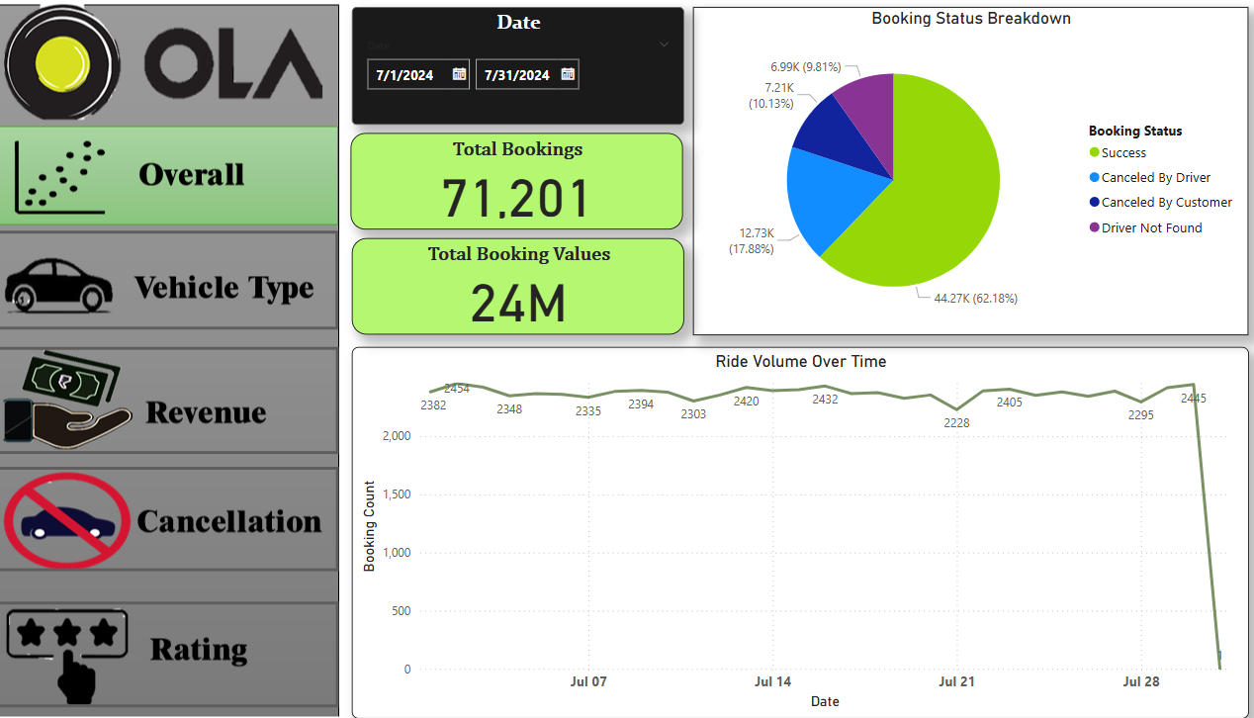
OLA Dashboard
Overall

Slide 3
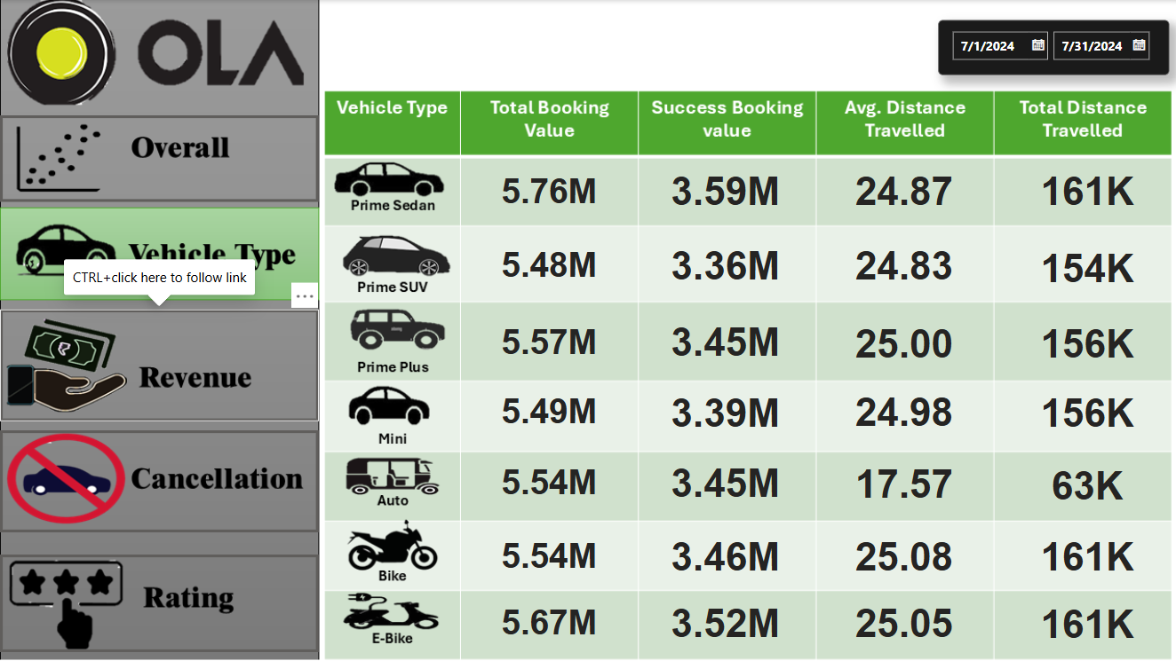
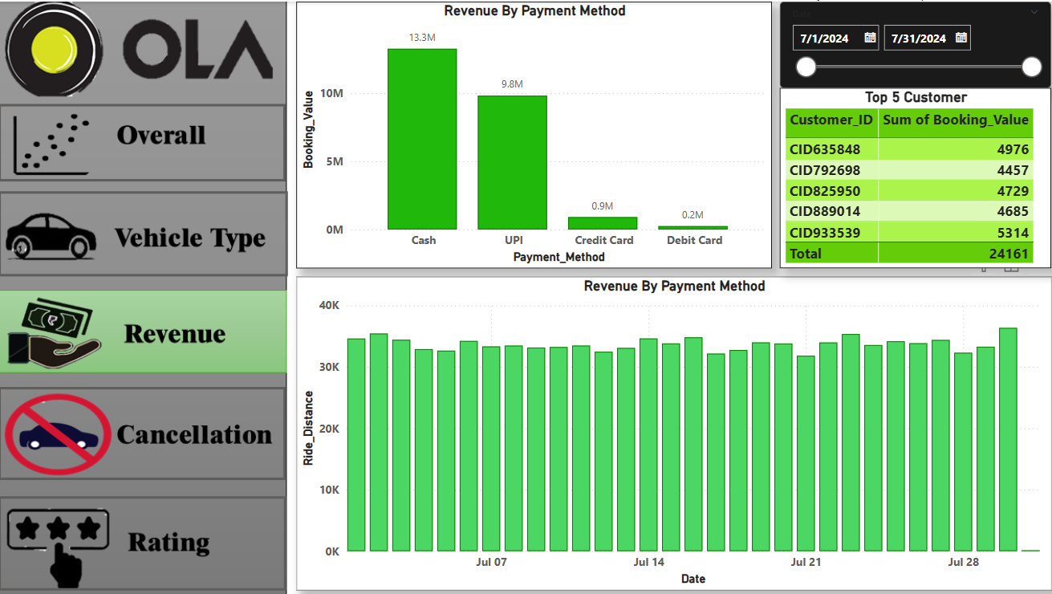
Vehicle Type
Revenue

Slide 4
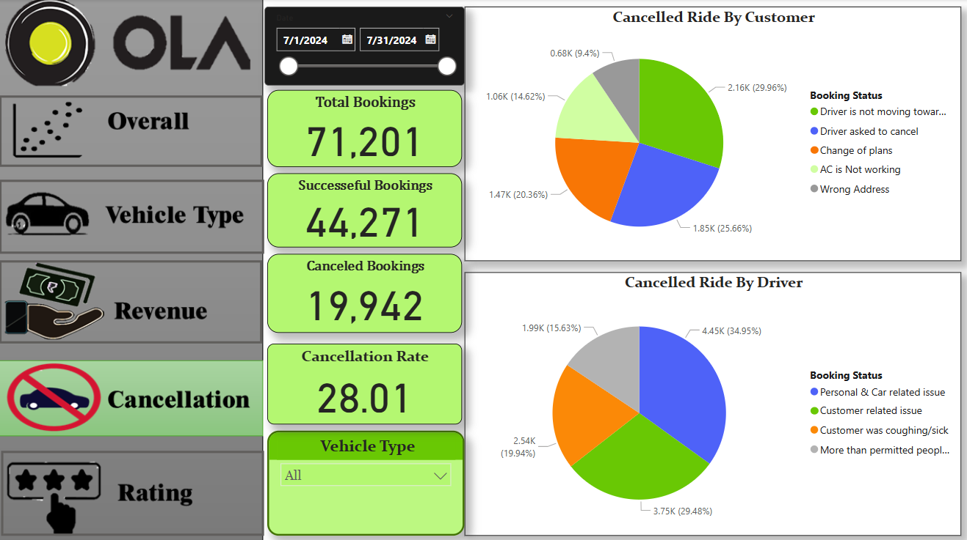
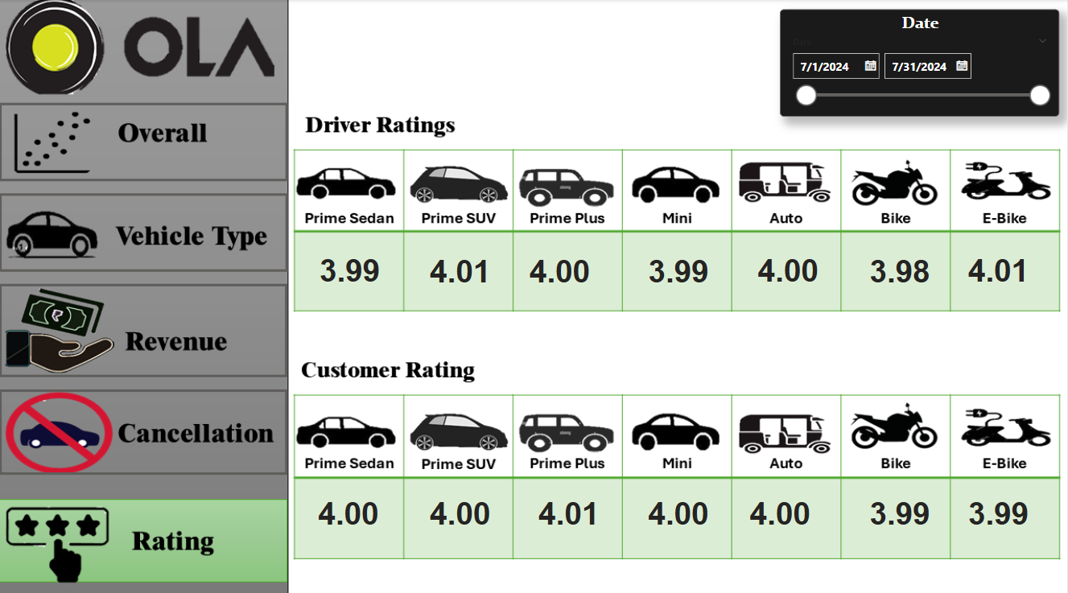
Cancellation
Rating

Slide 5

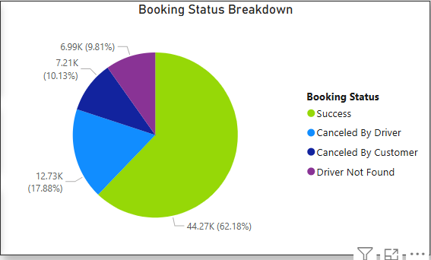
Booking Status Breakdown : This chart shows how booking requests were handled, using a pie chart to break down the status of all bookings. Here’s the simple explanation of each part: Green (Success): 62.18% of bookings (44.27K) were successful. Blue (Canceled by Driver): 17.88% of bookings (12.73K) were canceled by the driver. Dark Blue (Canceled by Customer): 10.13% of bookings (7.21K) were canceled by the customer. Purple (Driver Not Found): 9.81% of bookings (6.99K) couldn't find a driver at all. So, overall, most bookings were completed successfully, but nearly 38% faced some kind of issue—mostly cancellations or driver unavailability. The main motive for creating this chart is to understand how booking requests are being handled—basically, to get a quick and clear picture of what’s happening with customer bookings.

Slide 6
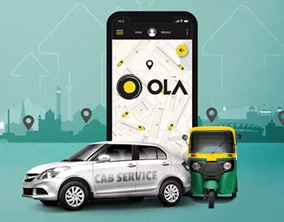
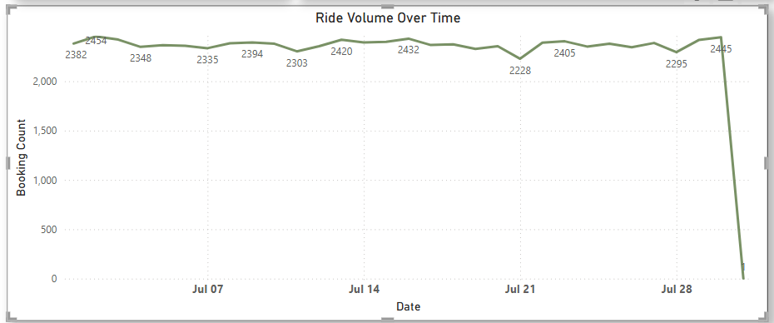
Ride Volume Over Time This line chart titled "Ride Volume Over Time" shows how many rides were booked each day over a period in July. Y-axis (vertical): The number of bookings per day (Booking Count). X-axis (horizontal): Dates throughout July. Each point on the line shows the ride volume for that day. Most days in July had between 2,200 and 2,454 bookings, showing a relatively stable booking trend. Purpose of this chart: To track demand over time. Identify trends, patterns, or sudden changes. Helps operations and management make decisions like: Adjusting driver availability. Investigating technical issues. Planning for peak or low-demand periods.

Slide 7
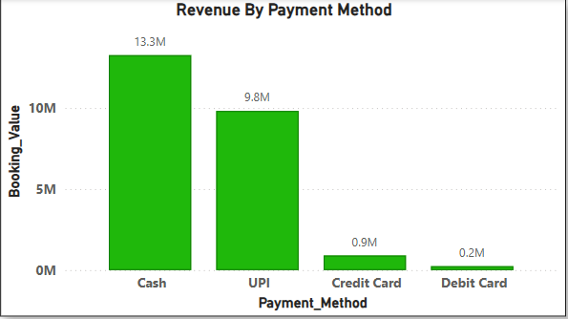
Revenue By Payment Method :
This bar chart titled "Revenue By Payment Method" shows how much revenue was collected through different types of payment options.
X-axis (horizontal): Types of payment methods — Cash, UPI, Credit Card, and Debit Card.
Y-axis (vertical): Total revenue (in millions) generated via each method — labeled as Booking_Value.
Each green bar represents the total revenue from that payment method.
Cash – 13.3 million : This is the most used payment method, contributing the highest revenue.
UPI (Unified Payments Interface) – 9.8 million : Second most popular digital method; widely used due to ease and speed.
Credit Card – 0.9 million : Very low usage compared to Cash and UPI.
Debit Card – 0.2 million : Least used option; almost negligible in comparison.
To analyze customer payment behavior.
Understand which payment modes are preferred.
Helps business:
Focus on improving popular methods (e.g., faster cash handling, better UPI integration).
Consider promotions or incentives for underused methods (like credit/debit cards)
Ensure smooth functioning and security of most-used payment options.
Most customers prefer Cash and UPI, while Card payments are rarely used. This can guide strategy for payment processing, offers, or app features.

Slide 8
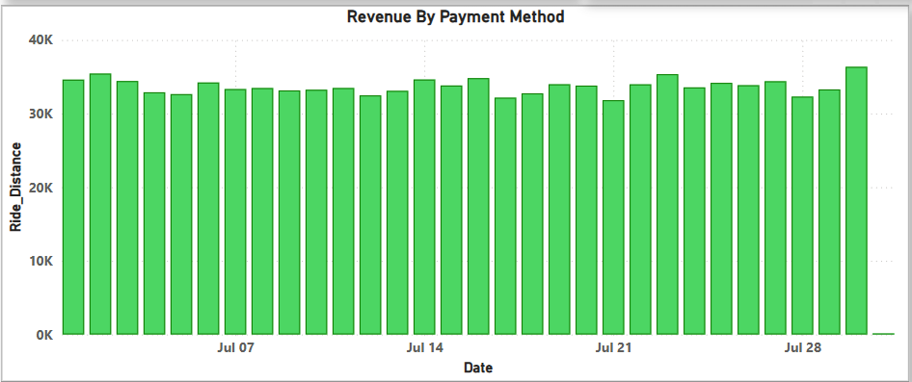
Revenue By Payment Method :
This bar chart titled "Revenue By Payment Method" (though the title seems slightly mismatched) is actually showing total ride distance over time.
X-axis (horizontal): Dates throughout the month of July.
Y-axis (vertical): Ride Distance (in thousands), which shows how far customers traveled in total on that date.
Bars: Each green bar represents the total distance traveled by all rides on a particular day.
. Purpose of This Chart:
To track overall ride activity (measured by distance) over time.
Helps in:
Understanding customer demand.
Planning fuel/maintenance resources.
Identifying peak days or slow periods.
Correlating ride distance with revenue or payment trends.
This chart gives a day-by-day snapshot of how much distance was covered by all rides. It's useful for monitoring travel demand and spotting any operational trends or anomalies.

Slide 9

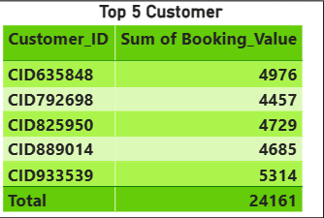
Top 5 Customer Table : This table titled "Top 5 Customer" shows the highest-spending customers based on their booking value (likely in currency units, such as INR or USD, depending on the context). Each row shows: A unique Customer_ID The sum of booking value (how much they’ve spent on rides) Top Customer: CID933539 spent the most, with a total of 5314. The total combined value of these top 5 customers is 24,161, showing they are significant contributors to revenue. These customers could be frequent riders, premium users, or even business account holders. Purpose of this chart: Identify and acknowledge high-value customers. Helps in: Loyalty programs or rewards for top users. Understanding user behavior for targeted promotions. Prioritizing customer service for high-value clients.

Slide 10
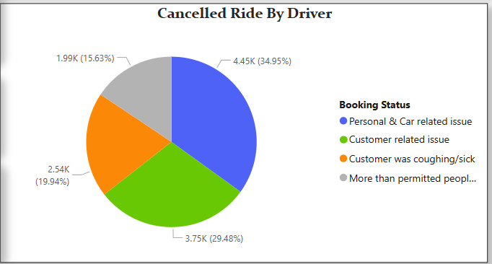
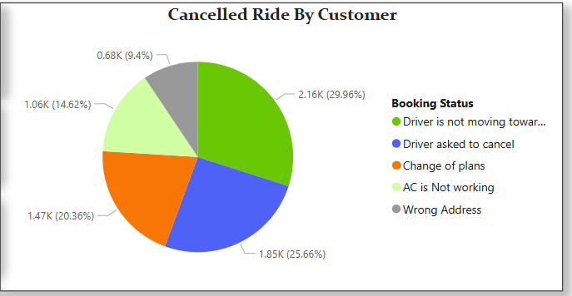
Cancelled Ride By Customer :
The motive for creating the "Cancelled Ride By Customer" chart is to analyze the reasons why customers cancel rides, so that the business can better manage operations and improve service.
Driver is not moving Towards (29.96%)
Driver asked the customer to cancel (25.66%)
Change of plans (20.36%)
AC not working (14.62%)
Wrong Address (9.4%)
This chart helps the company understand customer behavior, reduce cancellations, and improve both rider and driver experience through targeted actions.
Cancelled Ride By Driver :
This chart is titled "Cancelled Ride By Driver" and it breaks down the reasons why drivers cancelled rides. It's a pie chart that shows four categories of cancellation causes.
🔵 Personal & Car related issue – 4.45K (34.95%) : This is the biggest reason. It includes things like the driver feeling unwell, car problems, or emergencies.
🟢 Customer was coughing/sick – 3.75K (29.48%) : Drivers canceled because they thought the passenger might be sick—possibly for health and safety reasons.
🟠 Customer related issue – 2.54K (19.94%) : General issues with the customer, like wrong pickup location, being rude, or delaying too much.
⚪ More than permitted people – 1.99K (15.63%) : The ride was canceled because the customer tried to bring more passengers than allowed.
The chart helps the company analyze, improve, and manage ride cancellations more effectively, boosting both customer experience and driver performance.

Slide 11
Conclusion :
The Ola project was created to make travel easier, faster, and more convenient for people. Instead of waiting for taxis or buses, users can quickly book a ride anytime through their phones. The goal was to:
Help customers find rides easily.
Help drivers find more passengers and earn money.
Make the whole travel experience safer, faster, and more affordable.
By using technology, Ola connects riders and drivers smoothly, making city travel simple for everyone

Slide 12

Thank You

